Slide 1
Understanding Academic Impact

Slide 2
Background

Slide 3
Background
Public Law 211-2021
Charged IDOE to conduct a study of COVID-19’s impact on student learning outcomes for 2020/2021 and 2021/2022
American Rescue Plan Act
Requires states to reserve at least 5% of awarded grant funds to carry out activities to address the academic impacts of COVID-19
Academic Impact Study
IDOE contracted with the Center for Assessment to conduct research and analysis of COVID-19’s academic impact in Indiana

Slide 4
Background
Intentional, Targeted, & Evidence-Based Recovery Response
Who?
What?
Forward Looking
How Much?
Data are used prospectively , not retrospectively
Purpose is not to identify the cause of academic impact or to compare to historical performance; Purpose is to identify what supports are necessary to best serve Indiana students

Slide 5
Background
School Response
Classroom Observations
Local & Interim Assessment Data
Non-Assessment Data
State Academic Impact Data

Slide 6
What is Academic Impact?
Academic Impact
Measurement of whether student growth was faster or slower than pre-pandemic student growth
Comparison of how student achievement and student growth differ pre- and post-pandemic

Slide 7
What is Recovery Time?
Recovery Time
Recovery time is defined as returning to where students or groups of students would be under “normal” learning conditions
Recovery is NOT defined as attaining proficiency
Recovery time is dependent upon the degree of academic impact

Slide 8




Academic Impact & Recovery Time
All cars leave at 12pm, traveling at 60mph to reach destination by 4pm
12pm
1pm
2pm
3pm
4pm
2 Minute Delay
Continue at 60mph
Arrives On Time
30 Minute Delay
Increase speed to 75 mph
Arrives On Time
1 Hour Delay
Increase speed to 90 mph
Arrives On Time

Slide 9
Academic Impact & Recovery Time
Category | Recovery Time | Academic Supports
SIGNIFICANT | > one school year | Requires supplemental academic supports
MODERATE | ≤ one school year | Likely requires supplemental academic supports
MINOR/NO | minimal | Minimal, with minor deviations from general supports

Slide 10
The Findings

Slide 11
Who was Impacted?
Grades 5 to 8: Academic impacts were of comparable size within content area—likely that similar academic impacts extend across all K-12 grades
Demographic student groups: Experienced comparable impact by grade and content area
Academic student groups: Experienced different amounts of academic impact; English language learners experienced different amounts of impact depending upon grade level
Corporations and schools: Impacts were highly variable, with most corporations and schools experiencing significant academic impacts

Slide 12
What Content Areas Felt Impact?
Mathematics: Indiana students in elementary and middle school experienced academic impacts (ILEARN)
English/Language Arts: Indiana students in elementary and middle school experienced academic impacts (ILEARN)
English Language Proficiency: English language learners in elementary and middle school experienced academic impacts (WIDA ACCESS 2.0)
Other Subject Areas: Likely that similar academic impacts extend to other content areas

Slide 13
How Much Impact was Experienced?
The academic impacts of the pandemic were substantial, ranging from MODERATE to SIGNIFICANT
2021 WIDA ACCESS 2.0 assessment data confirms SIGNIFICANT academic impact for most English language learners
In the isolated contexts where MINOR/NO impacts were observed, questions about the efficacy of education pre-pandemic are a concern
Rates of learning required for recovery are unprecedented at the scale required to return to where students or groups of students would be under normal learning conditions

Slide 14
Specific Areas of Concern
Type 1: Issues resulting from the pandemic
Academic impact in mathematics is consistently SIGNIFICANT and across all grades
Academic impact in English/language arts are MODERATE to SIGNIFICANT across all grades
Likelihood that academic impacts experienced in mathematics and English/language arts extend across all K-12 grades and to other content areas

Slide 15
Specific Areas of Concern
Type 2: Issues existing before the pandemic
English language learners in high school show MINOR/NO impact during the pandemic
Special education students statewide experienced MODERATE impact during the pandemic
Lowest achievers statewide show MINOR/NO decline impact the pandemic

Slide 16
The Response

Slide 17
Response to Academic Impact
Comprehensive, Multi-Year Response
Intervention Strategies & Support
Funding Availability & Targeted Use
Understanding Data & Academic Impact

Slide 18
Understanding Data
2020-2021 Academic Impact Report
Available to schools and corporations through the accountability portal (https://accountability.doe.in.gov)
Provides academic impact data on student-level performance, based on ILEARN assessments
For informational purposes only—this data will not be used for any school accountability purposes
To be used alongside local assessment data and non-assessment data

Slide 19
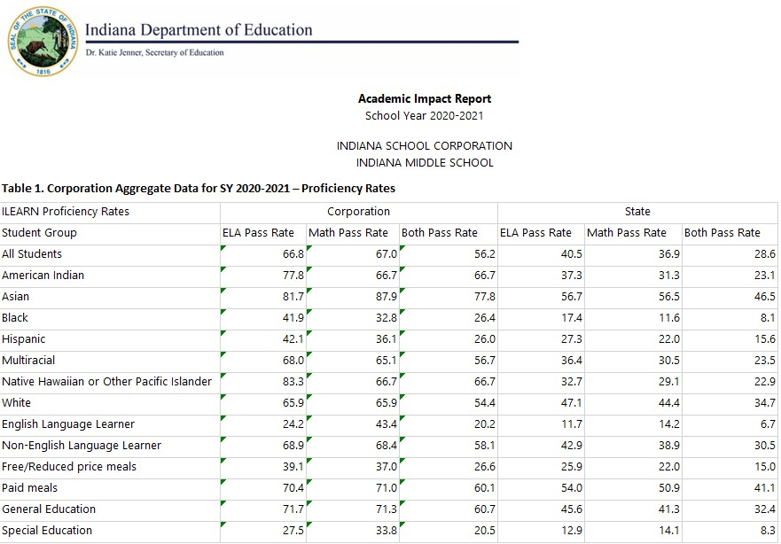
Understanding Data

Slide 20
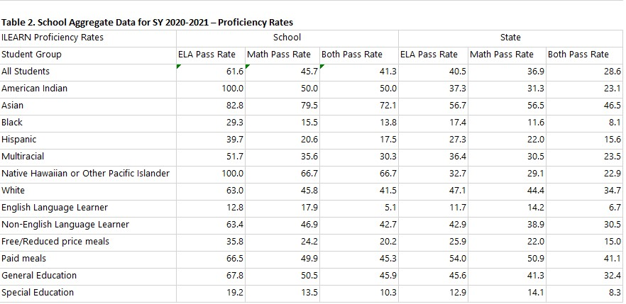
Understanding Data

Slide 21
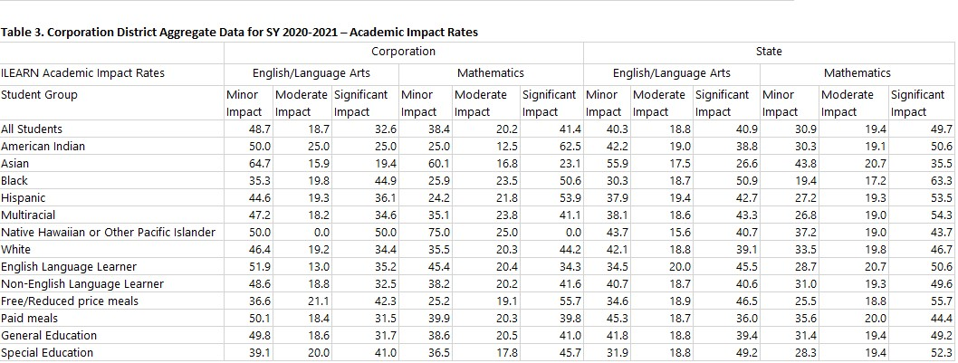
Understanding Data

Slide 22
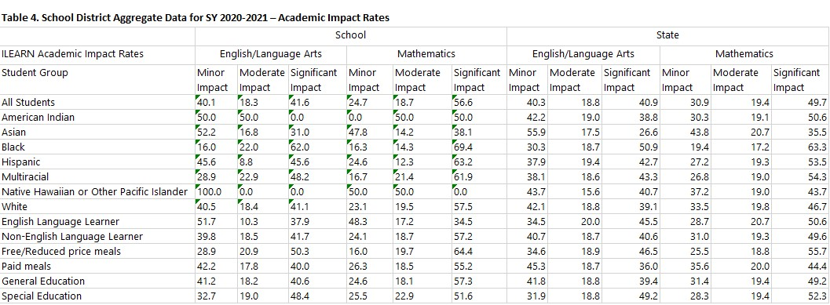
Understanding Data

Slide 23
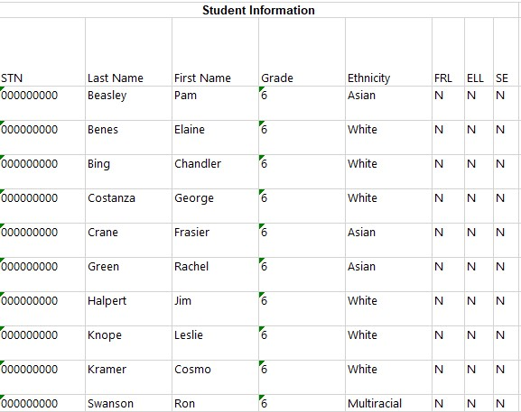
Understanding Data

Slide 24
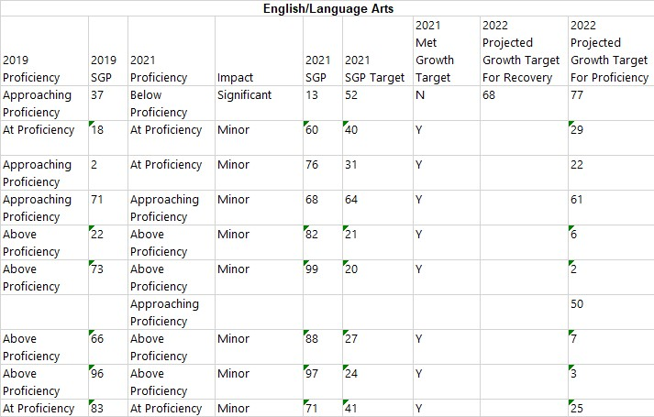
Understanding Data
1
2
3

Slide 25
Using Data
Students who were below or approaching proficiency in 2019
Filter “2019 proficiency” to “below proficiency” & “approaching proficiency”
Filter “2021 proficiency” to “below proficiency” & “approaching proficiency”
Filter “impact” to “significant” and “moderate”
Filter to consider ethnicity, special education, English learners

Slide 26
Using Data
Students who were at or above proficiency in 2019
Filter “2019 proficiency” to “at proficiency” & “above proficiency”
Filter “2021 proficiency” to “below proficiency” & “approaching proficiency”
Filter “impact” to “significant”
Filter to consider ethnicity, special education, English learners

Slide 27

Standards in Essential Need of Support (SENS)
Standards where students are performing significantly below expectations
Standards containing content/skills essential for future success
Standards in Essential Need of Support
Notes:
SENS are standards which contain content and skills essential for student success and for which data indicate students are performing significantly below expectations.
SENS are not content priorities alone, nor are they intended to remove standards from teaching and learning plans. Some standards may contain important content and skills, but students are performing well, so the standards are not identified as in essential need of support. Other standards may be performing significantly below expectations but do not include highest priority content, so the standards are not identified as in essential need of support.

Slide 28
How Schools Can Use SENS
Consider additional support for the standards
Curricular planning (time spent and ordering)
Themes of support (specific to content areas)
Consider local application of the process
Is local student performance showing the same areas of need as statewide student performance?
Can schools and districts engage with one another to learn from each other if there are differences?
Professional learning for teachers
Additional supports or resources for instruction and learning
Differentiated support
Notes:
Schools should consider how they can provide additional support for these standards and how they may engage in a similar identification process at the local level to determine any local variations. Schools can also apply IDOE's process (described on the next slide) to their own performance data to determine any local variations. IDOE provides templates and process documents to make the identification process at the local level quick and easy.

Slide 29
IDOE's SENS Identification Process
Quantitative Identification Steps | Identify grade-level content priorities (grade-level ILEARN blueprints). Assign higher values for higher priority.
 | Identify next-grade-level content priorities (vertically aligned standard reflected in the next-grade-level ILEARN blueprints). Assign higher values for higher priority.
 | Identify the proficiency level acquired for that standard on the most recent ILEARN assessment. Assign higher values for lower performance.
 | Compare the performance of each standard on ILEARN with data from interim assessment providers and adjust for discrepancies, as needed.
 | Add all the values assigned to the standards for a total indicator. Identify the top 10-15 (using natural breaks found in the final values as a guide) as SENS.
Qualitative Identification Steps | Content-area experts review identified SENS for overall themes and to ensure they align with current classroom experiences. Outliers or standards which are “borderline” are reviewed to determine the level of support needed.
 | Confirm findings with interim/benchmark assessment providers.
 | Finalize list of SENS based on all data and reviews.
Notes:
IDOE began with a quantitative, data-driven process to identify an initial list of SENS. The quantitative process considered content priorities, as defined by Indiana educator committees, identified in the assessment blueprints and performance data (from ILEARN and interim/benchmark assessments). Then, Indiana educator content experts reviewed the initial list of identified standards and provided qualitative feedback from current classroom experience. Schools may access these templates for English/language arts and mathematics and the accompanying process documents to support a local application of the process, if desired. Template documents address grades three through eight only as kindergarten through grade two use data compiled from various interim assessment providers which may not be available to all school corporations.

Slide 30

Learning Lab (add slides from SBOE)

Slide 31
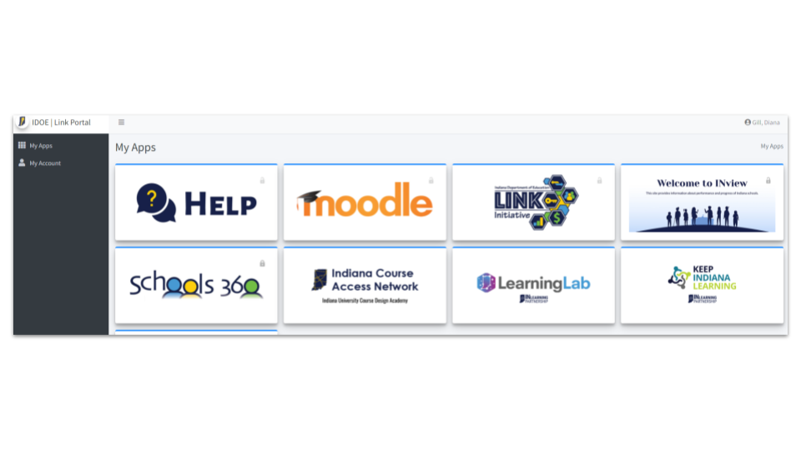

Slide 32
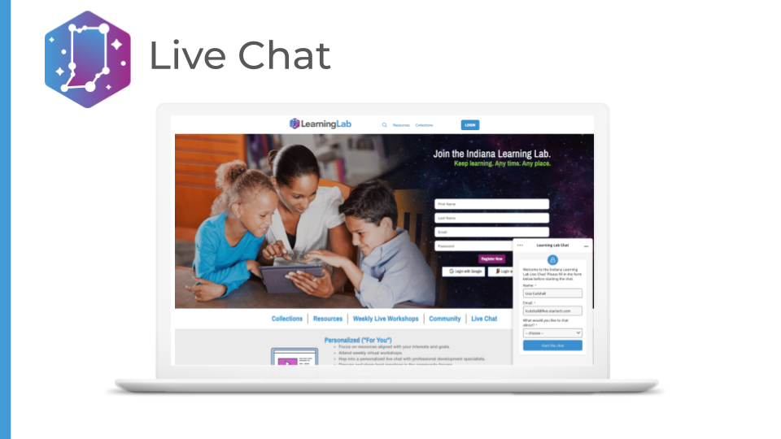

Slide 33


Slide 34


Slide 35


Slide 36


Slide 37
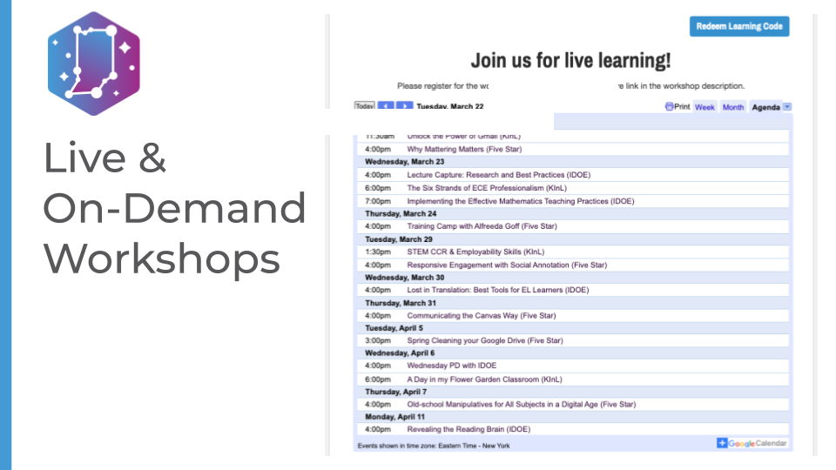

Slide 38


Slide 39


Slide 40
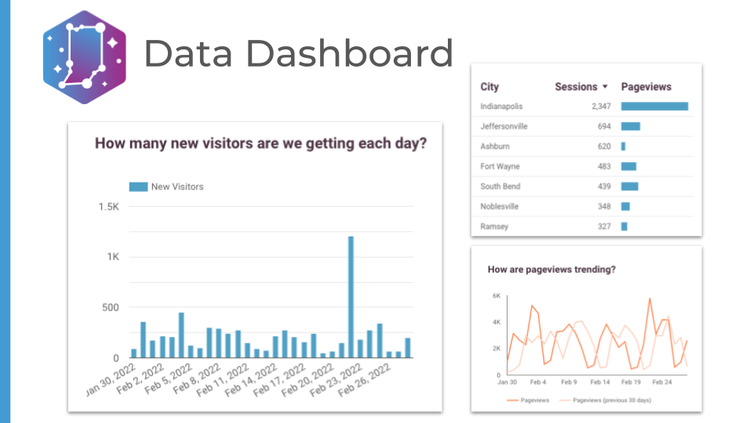

Slide 41
EARLY LITERACY PRIORITIES DEFINED
1
2
3
Offer opportunity and support for Science of Reading implementation throughout Indiana schools.
Facilitate high-quality, ongoing, data-driven professional development for educators.
Increase access to quality literacy interventions, remediation, and enrichment for all students.
Notes:
Our response, aka priorities.

Slide 42
Stem PRIORITIES DEFINED
1
2
3
Refine STEM pedagogy with research-based best practices.
Develop STEM leaders and educators.
Increase access to STEM courses, programs, and resources.
Notes:
Our response, aka priorities.

Slide 43
WHAT DOES IMPLEMENTATION LOOK LIKE?
A subset of high-need schools (100) has been identified to collaborate with IDOE.
IDOE will partner with leaders at these schools over the next two years to interview, hire, and assign literacy (50) and STEM (50) coaches to serve in their school building.
This model intends for active participation by schools to ensure success.
Corporations and schools outside of the high-need classification (up to 100) may opt in as part of a voluntary coalition.
These schools will receive the same training and resources over the next two years.
Through this effort, minimum assurances and expectations will be defined for participation.
Notes:
Recruitment and next steps

Slide 44
Why Coaching is key
Why Use a Coaching Model?
Instructional Coach Role
Research shows traditional professional development does not promote instructional change. (Darling-Hammond and Richardson 2009)
“Effective professional development needs to be ongoing, providing sustained opportunity for teachers to come together to collaborate and learn from one another.” (Yoon, et al. 2007)
Two-year implementation plan to see significant impact in student achievement (Campbell and Malkus, 2011).
Provide professional development:
at school, grade, and individual levels;
at regular intervals, over an extended period of time;
modified to meet the needs of students in the classroom; and
modeling or demonstrating research-based teaching methods.
Co-plan with teachers and grade-level leaders.
Co-teach to implement new strategies.
Mentor new teachers in specific content areas.
Build instructional capacity.
Notes:
Include as an example of the response/model. Coaching is KEY to the successful implementation of STEM and LIT plans.

Slide 45
NEXT STEPS: Coaching Recruitment
Year One
IDOE will recruit targeted and opt-in schools and vet coaching candidates identified by local districts.
Vendor will provide training, ongoing support, and program evaluation.
Year Two
Vendor will recruit targeted and opt-in schools and vet coaching candidates identified by local districts.
Vendor will provide training, ongoing support, and program evaluation.
Engagement with first year coaches will continue alongside second year coaches.
Notes:
Recruitment and next steps

Slide 46
Thank you!

